Slide 1
AHB2APB Bridge Verification
P V M Vamsi

Slide 2

AMBA
CHI
Coherent Hub Interface
ACE
AXI Coherency Extension
AXI
Adv. eXtensible Interface
AHB Adv. High Performance Bus
APB
Advanced Peripheral Bus

Slide 3
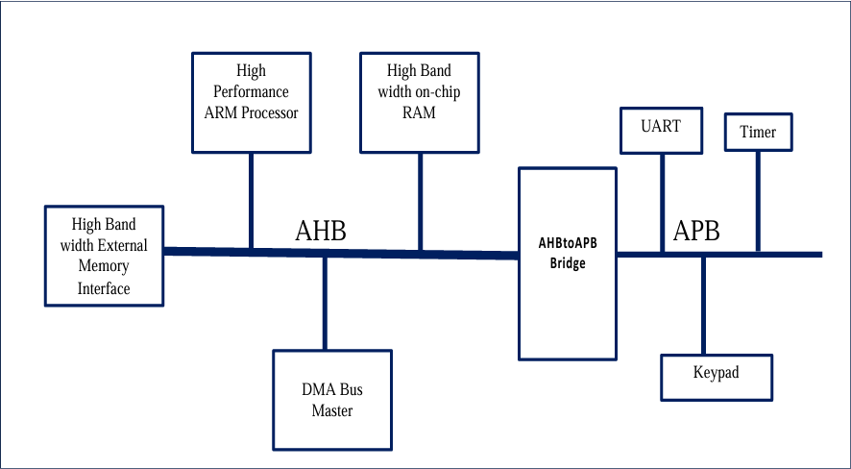
Typical AMBA System

Slide 4
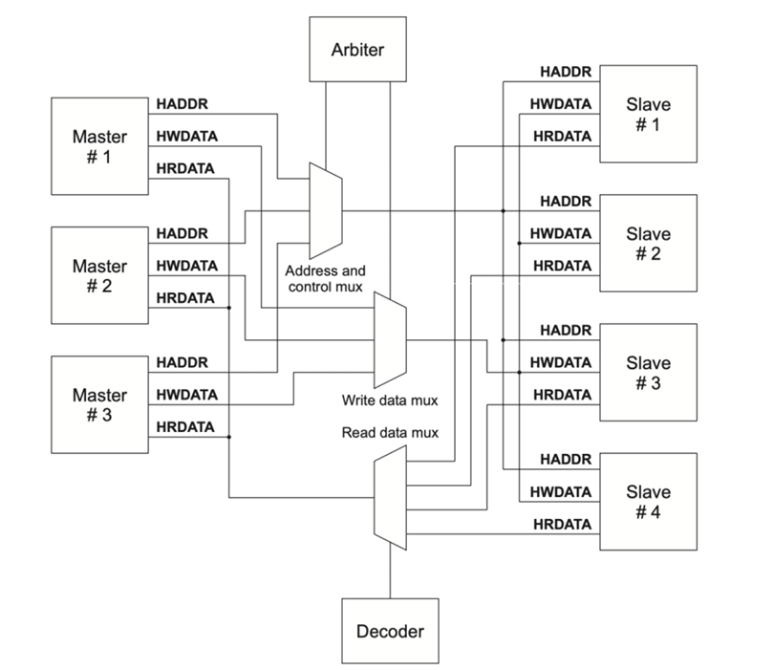
AHB

Slide 5
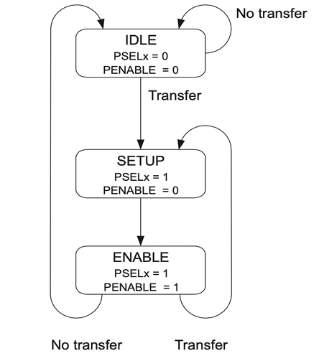
APB

Slide 6
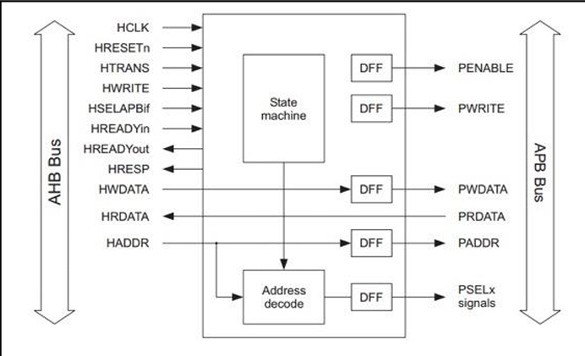
AHB to APB Bridge

Slide 7
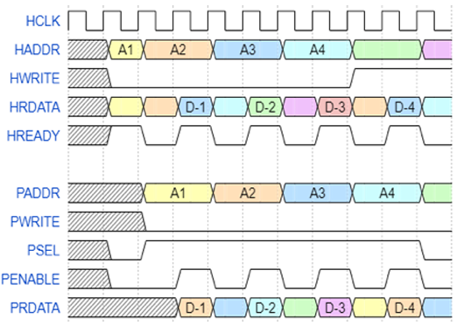
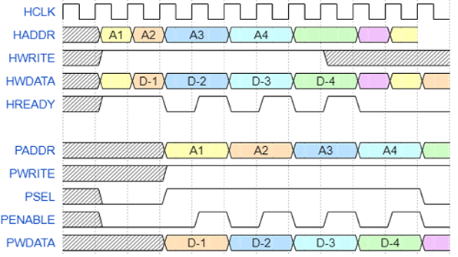
Waveform
Read Transfer
Write Transfer

Slide 8
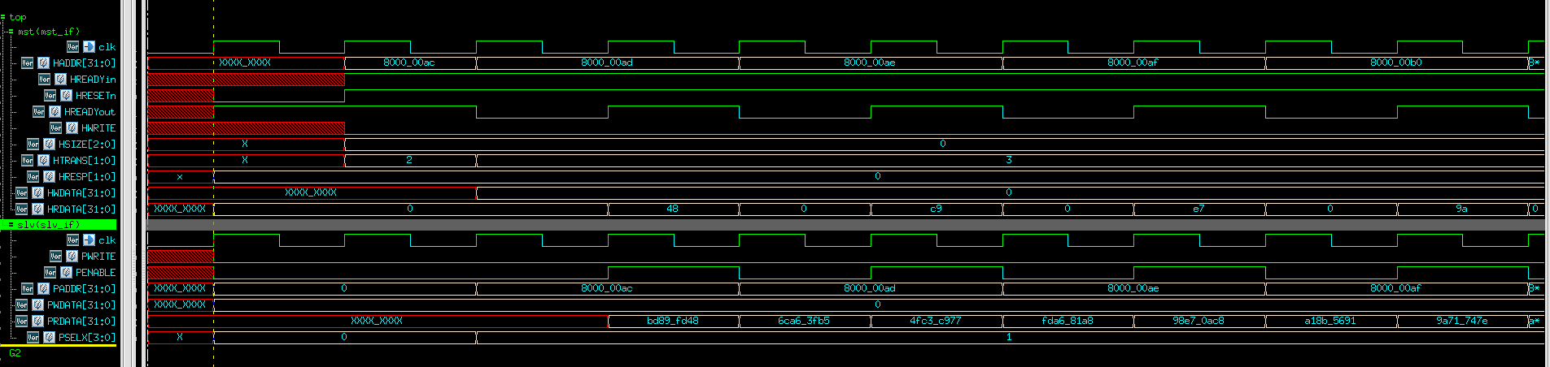
Output Waveform

Slide 9
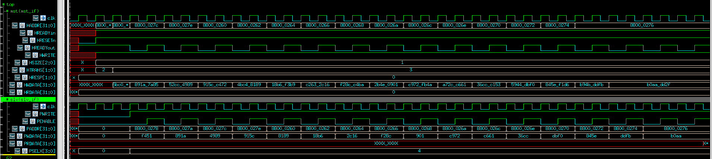
Output Waveform

Slide 10
Conclusion
Challenges
Driving and monitoring logic.
Scoreboard.
Coverage.
The AHB to APB Bridge verification using UVM was successfully completed, with proper functionality of drivers and monitors, and data matching in the scoreboard, confirming the bridge design's correctness.

Slide 11
THANKYOU

